Slide 1

Bank Analytics
Analyzing Key Performance
Indicators For Strategic Insights
Group : 3

Slide 2

Group -3 Members
KARTIKEYEA SINGH
RAGHAVA RAO PUTCHAKAYALA
MINAL RAJARAM GARATE
DEVARAKONDA PAVAN
SHRINIWAS ANANTRAO JOSHI
NAVEENA MUDDA

Slide 3
Data overview
Data Characteristics
Time period
2007-2016
Geographic Coverage
The data includes loans from various states across United States
Total Customers
40 K
Data set
40k rows
51 columns
Data Cleaning
Merged the two data sets Fianance_1 and Finance_2
Missing values were handled by imputation or removal, ensuring the dataset is complete and ready for analysis.

Slide 4

Objective
Year wise loan amount Stats
Grade and sub grade wise revol_bal
Total Payment for Verified Status Vs Total Payment for Non Verified Status
State wise and month wise loan status
Home ownership Vs last payment date stats

Slide 5
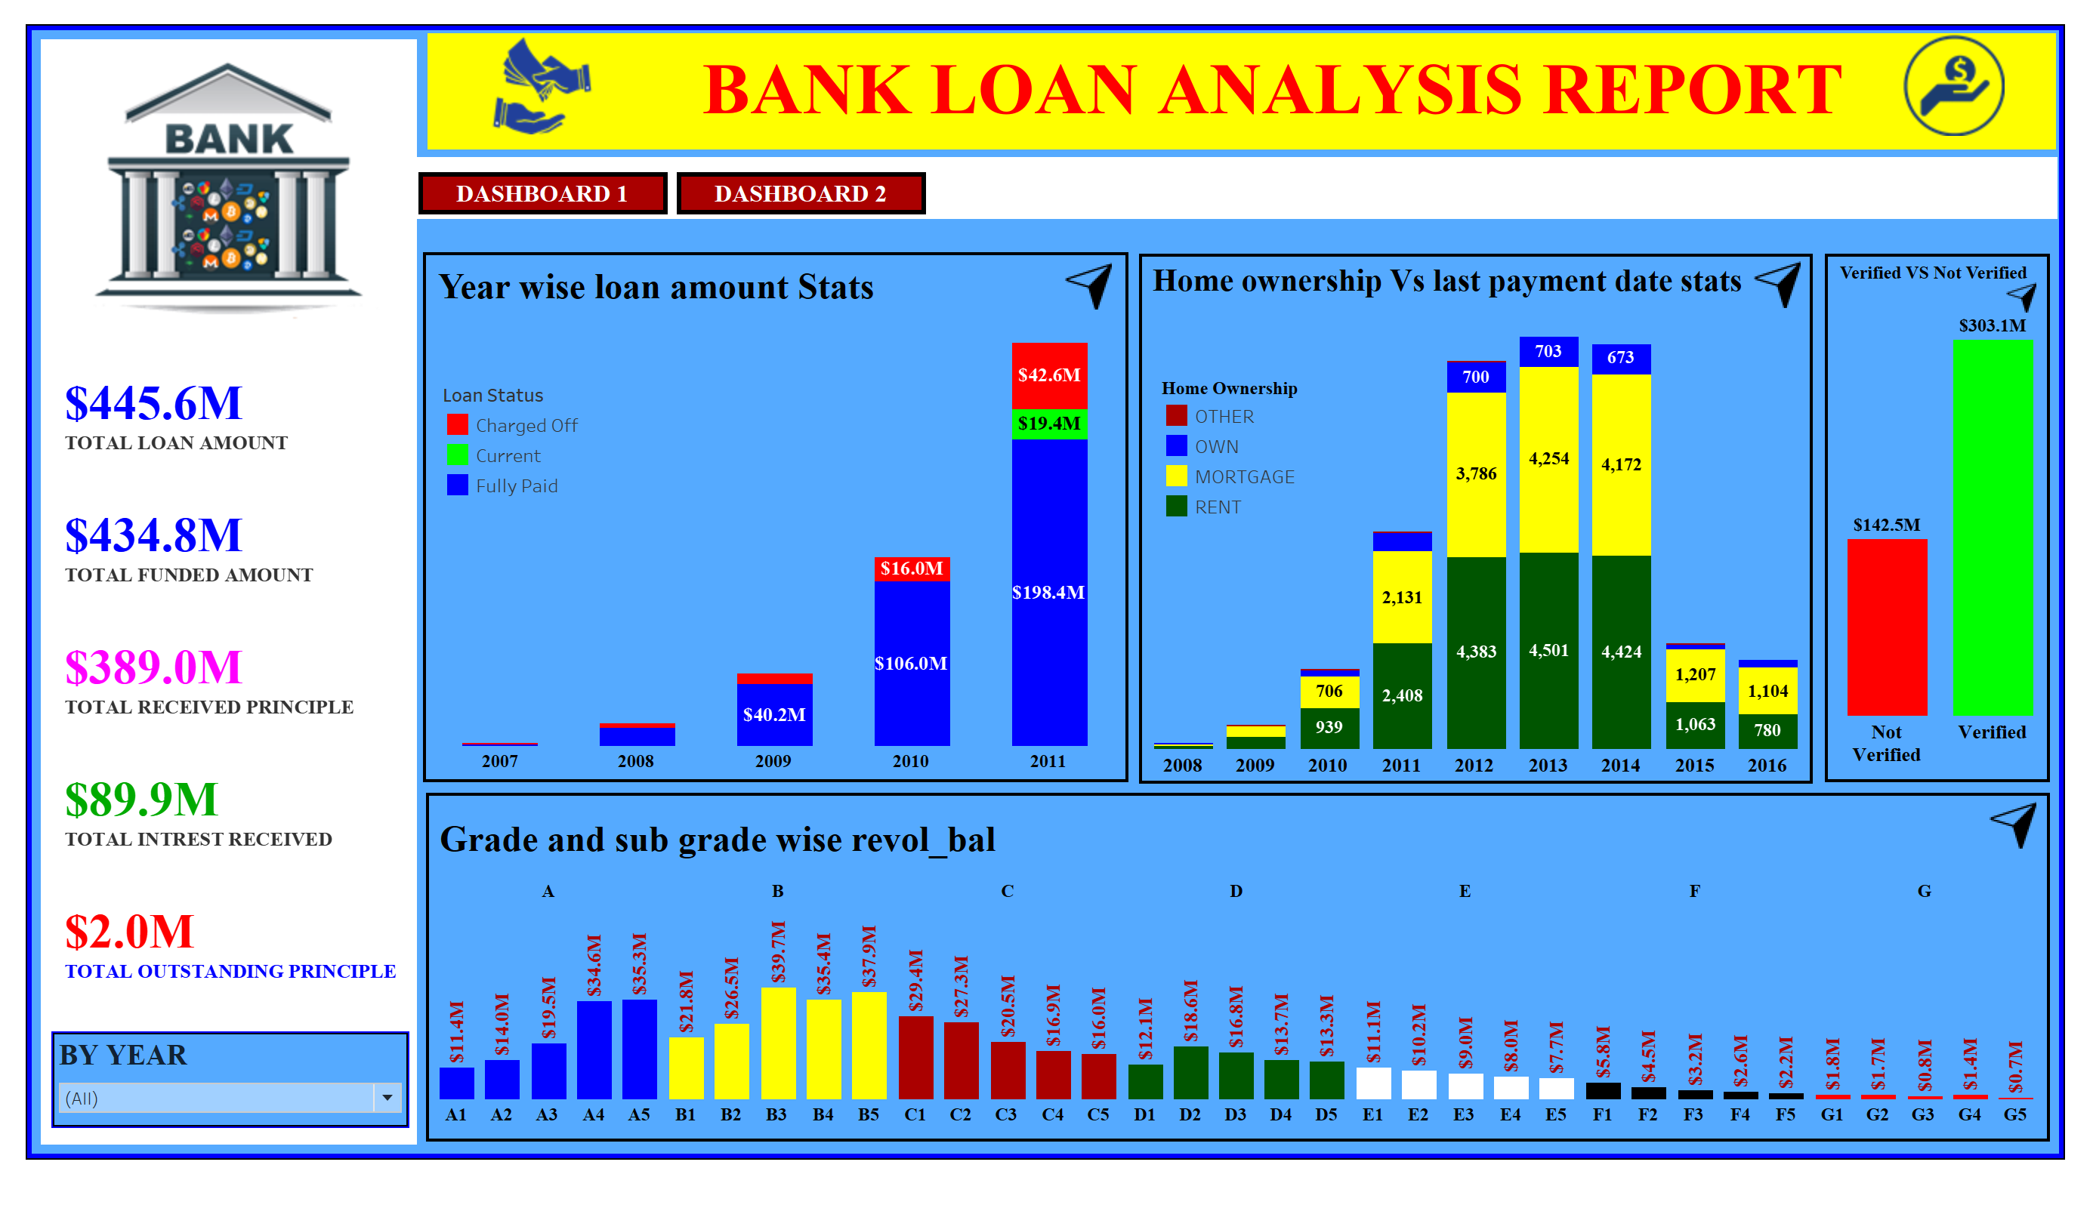

Slide 6
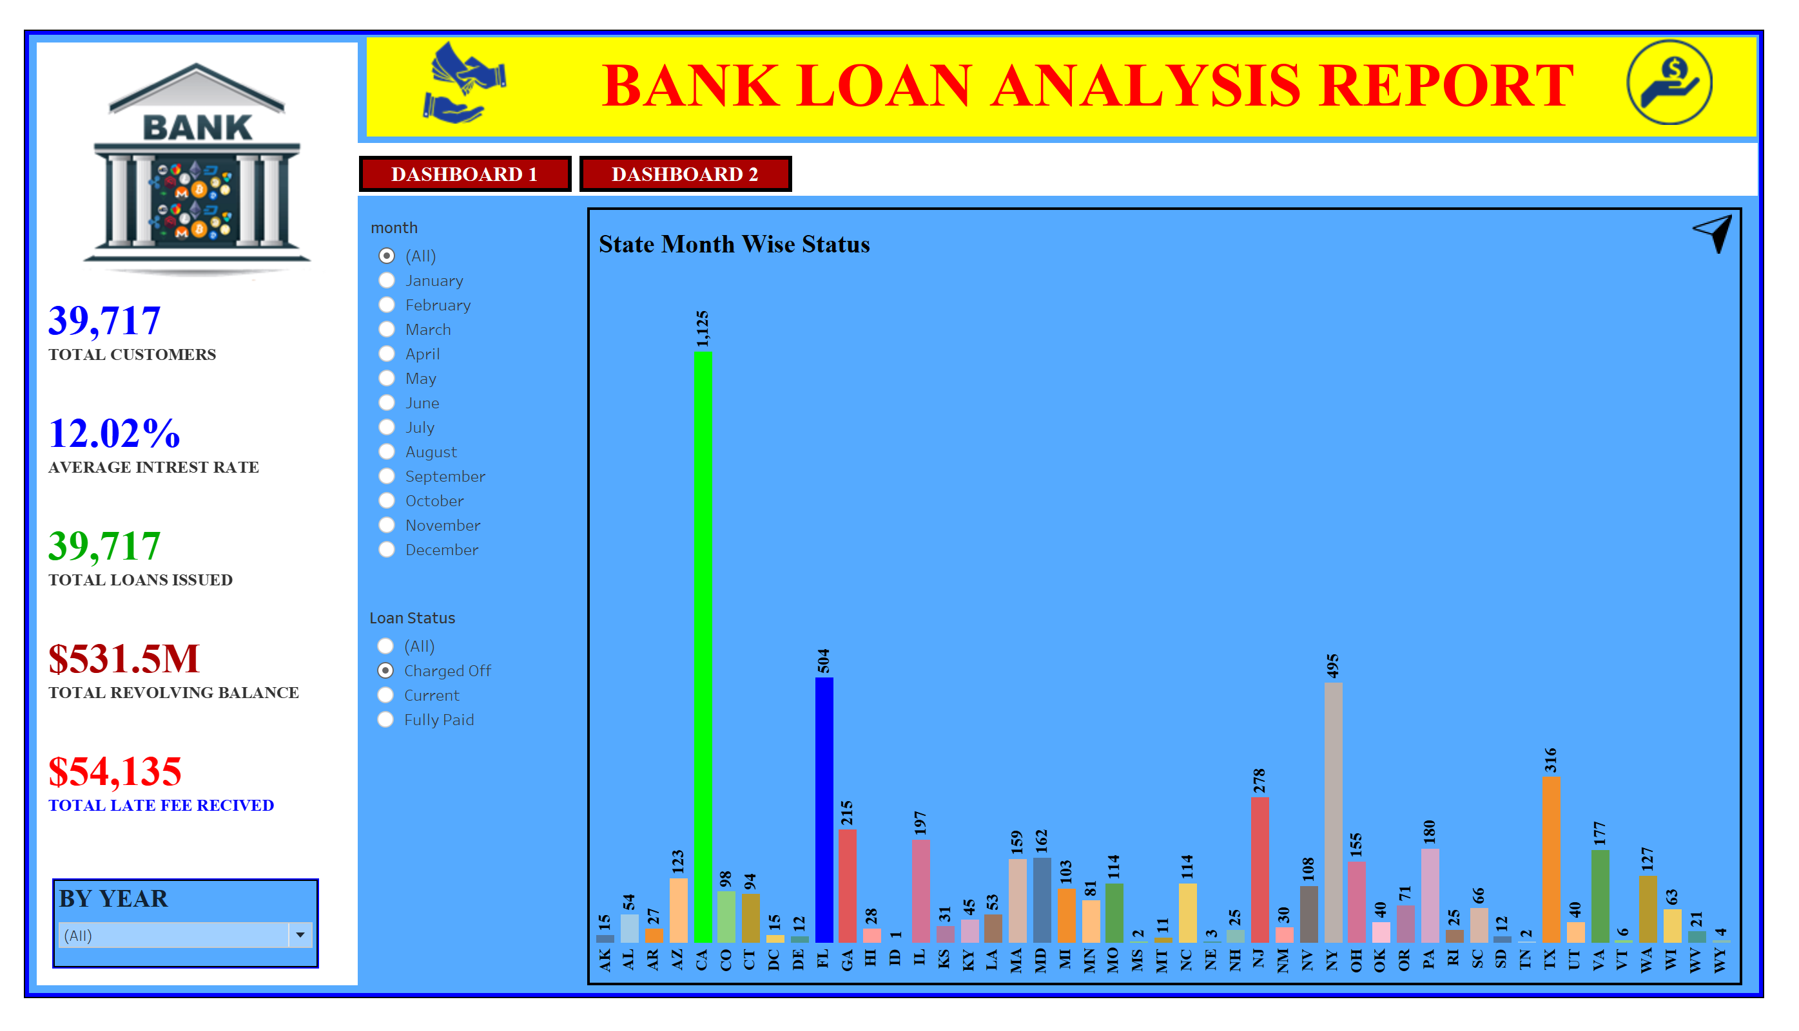

Slide 7
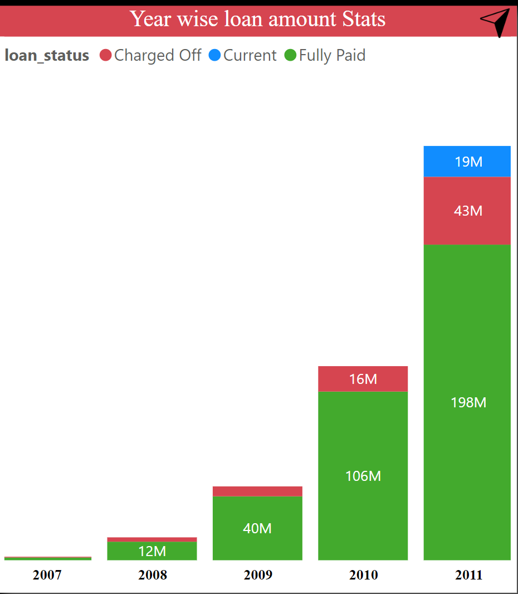
Objective
Summary:
Both Fully Paid and Charged Off loan amounts trended up significantly between 2007 and 2011.
Anomalies in loan amounts were observed, particularly in Charged Off loans in 2011.
Understanding these trends helps in better risk management and decision-making.
The significant growth in Fully Paid loans indicates improved repayment behaviors or changes in lending policies.
Year wise loan amount Stats

Slide 8
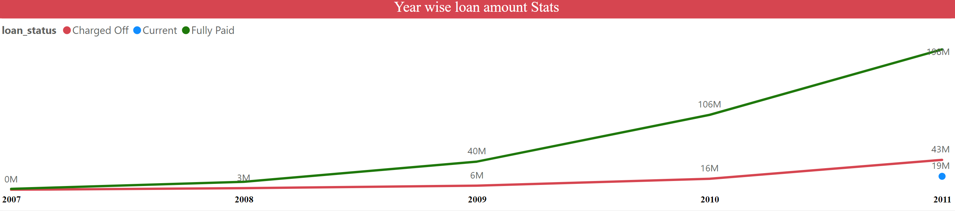
Year wise loan amount Stats
RECOMENDATIONS:
1. Streamline Application Process: Simplify and expedite the loan application process to make it more user-friendly.
2. Customer Support: Provide excellent customer support with multiple channels (phone, chat, email) for quick assistance.
3. Incentivize Referrals: Implement a referral program that rewards existing customers for bringing in new clients.
4. Attractive Rates: Offer competitive interest rates and terms to attract more customers.
5. Mobile App: Develop a mobile app to provide convenient access to loan services and account management.
6. Strengthen Collections: Develop proactive collections strategies and offer flexible repayment plans.

Slide 9
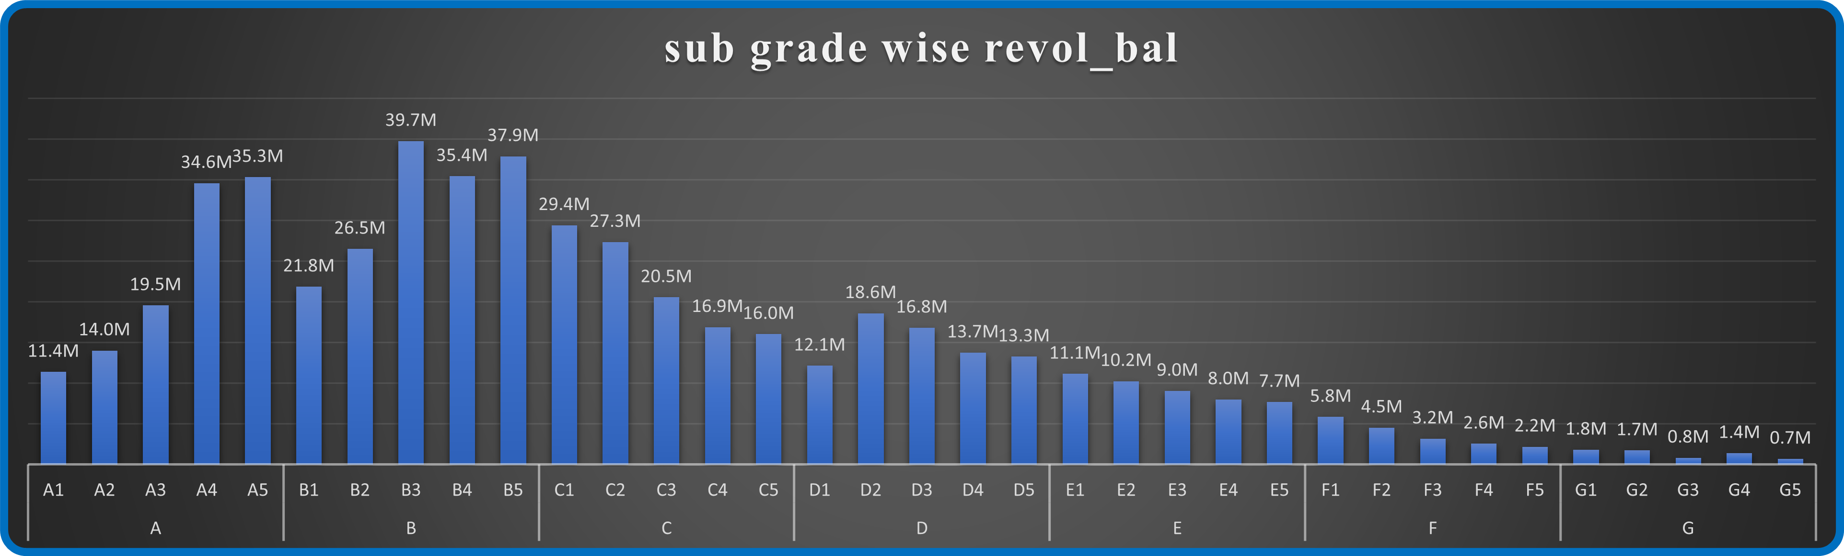
Objective
2. Grade and sub grade wise revol_bal
Summary:
The analysis of revolving balances across grades and sub-grades reveals diverse patterns and implications
for credit risk management and portfolio optimization. Notably, higher revolving balances are concentrated
in grades A and B, suggesting lower credit risk and potentially higher profitability. Understanding these
distribution trends is crucial for tailoring lending strategies and optimizing portfolio performance.

Slide 10
2. Grade and sub grade wise revol_bal
RECOMENDATIONS:
1. Focus on Grades A and B: Prioritize lending and offer higher credit limits to these lower-risk, higher-profitability segments.
2. Interest Rates: Apply lower rates for grades A and B, and higher rates for riskier grades.
3. Monitor Lower Grades: Implement stricter monitoring for grades C and below.
4. Regular Audits: Conduct audits to maintain compliance and improve risk management.

Slide 11
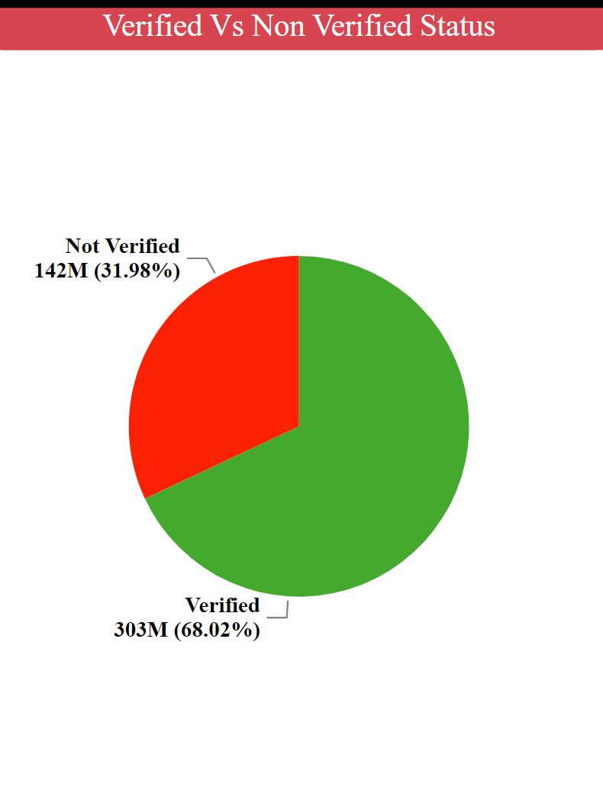
Objective
3. Total Payment for Verified Status Vs Total Payment for Non Verified Status
Summary:
Verified customers contribute significantly higher total payments
($303M) compared to non-verified customers ($142M), indicating
verified status as a reliable indicator of creditworthiness.
This insight guides risk assessment, lending strategies, and
verification process optimization, enhancing portfolio performance
and regulatory compliance. Verified status plays a pivotal role in
decision-making, ensuring effective risk management
and improved repayment outcomes.

Slide 12
3. Total Payment for Verified Status Vs Total Payment for Non Verified Status
RECOMENDATIONS:
1. Enhance Verification Processes: Implement multi-step verification with document, biometric, and identity verification services, using fraud detection algorithms.
2. Tailor Engagement for Verified Customers: Offer exclusive benefits like newsletters, loyalty programs, and preferential rates on financial products.
3. Implement Risk-Based Pricing: Offer lower rates or higher limits for verified customers using predictive analytics for accurate risk assessment.
4. Monitor Repayment Behavior: Utilize real-time transaction monitoring and automated alerts to identify default risks proactively.
5. Educate Non-Verified Customers: Launch educational campaigns on verification benefits and provide user-friendly guides for completion.

Slide 13
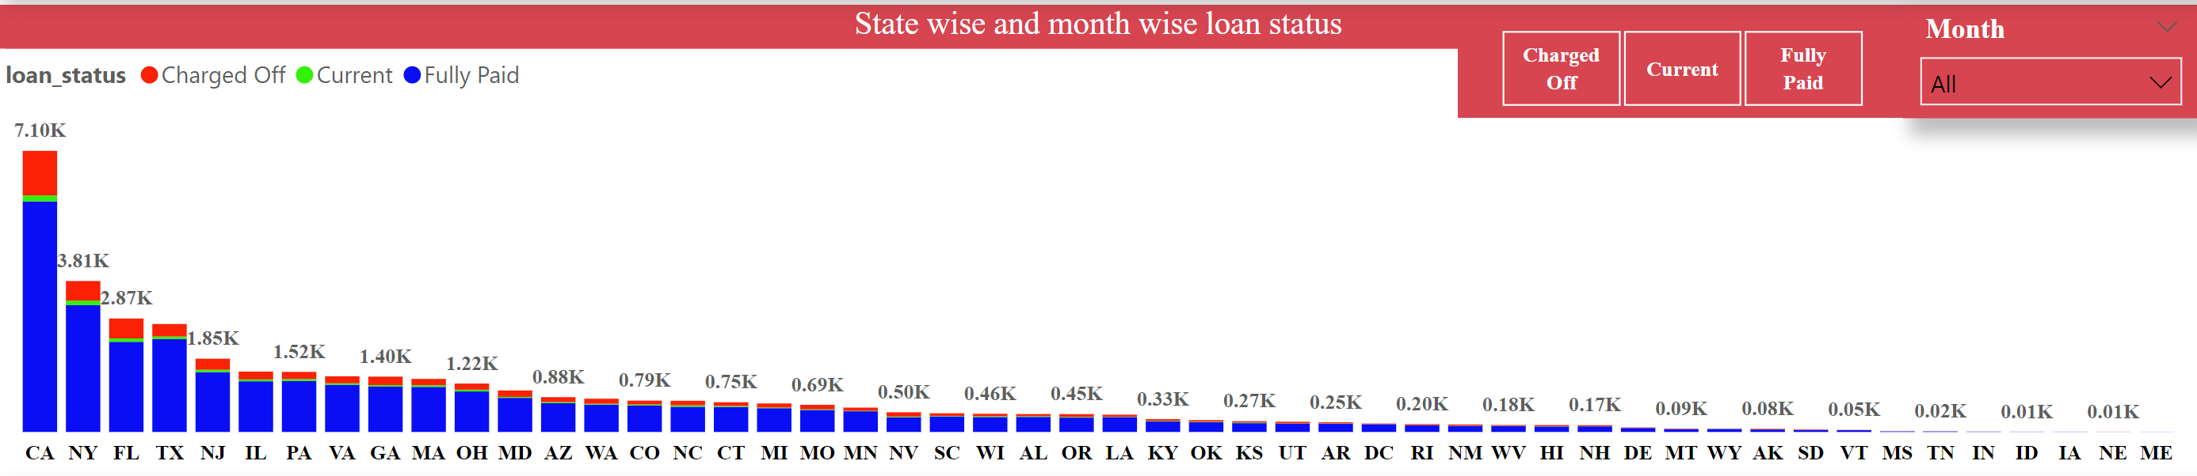
4. State wise and month wise loan status
1. High Loan Activity States:
California (CA): Highest activity with 7.10K loans, mainly Fully Paid.
New York (NY) and Florida (FL): Significant activity with 3.81K and 2.87K loans, respectively, predominantly Fully Paid.
2. Moderate Loan Activity States:
Texas (TX), New Jersey (NJ), Illinois (IL): Moderate activity with a mix of Fully Paid and Charged Off loans.
3. Low Loan Activity States:
States like Rhode Island (RI), New Mexico (NM), Hawaii (HI):Low loan activity, fewer than 0.20K loans each.

Slide 14
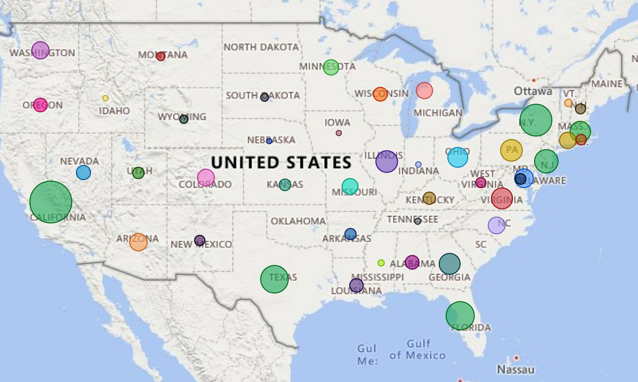
4. State wise and month wise loan status
RECOMENDATIONS:
1. Boost Marketing and Support: Focus on CA, NY, FL to capitalize on high activity.
2. Moderate Activity States: Growth Strategies: Increase applications in TX, NJ, IL.
Retention Programs: Offer incentives for timely repayments.
3. Low Activity States: Market Penetration: Increase marketing in states with low activity.
Tailored Offerings: Customize loan products to local needs.

Slide 15
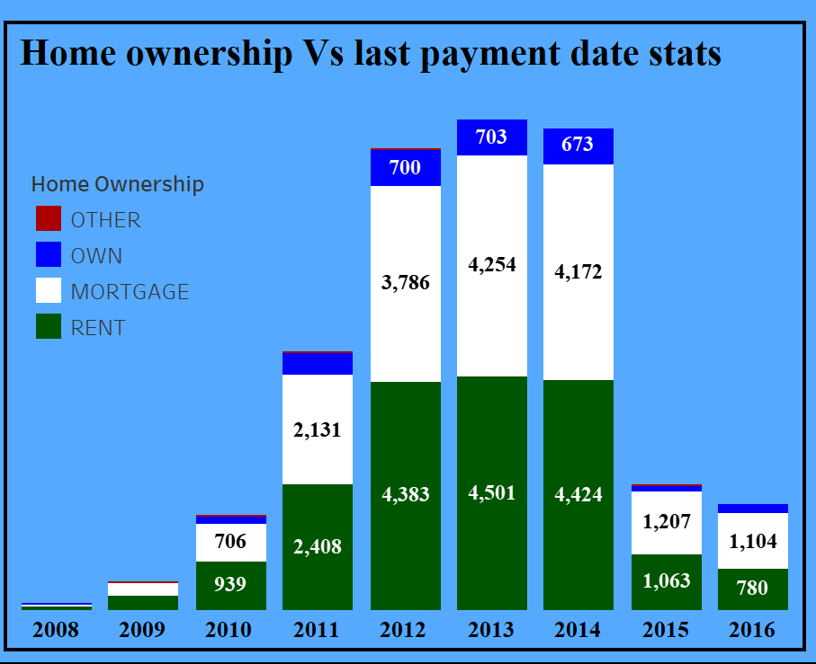
5. Home ownership Vs last payment date stats
1. Trends in Home Ownership:
Mortgage: Dominates from 2011 to 2014, peaking in 2013 with 4,501 loans.
Rent: Significant presence, peaking in 2013 with 4,383 loans.
Own: Relatively low but consistent numbers, peaking in 2013 with 703 loans.
Other: Minimal presence throughout the years.
2. Yearly Patterns:
2011 to 2014: Highest loan volumes, with a peak in 2013.
2015-2016: Noticeable decline in overall loan numbers compared to the
2011- 2014 period.
2008-2010:Very low loan volumes, with a gradual increase leading up to 2011.

Slide 16
5. Home ownership Vs last payment date stats
RECOMENDATIONS:
1.Target Mortgage Holders:
Tailored Products - Develop loan products specifically for mortgage holders, as they form the largest segment.
Refinancing Options - Offer refinancing options to attract and retain mortgage borrowers.
2. Focus on Renters:
Rental Market Products: Create loan products that cater to renters, who also represent a significant portion of borrowers.
First-time Buyer Programs: Introduce programs to help renters transition to homeownership, which can be a new growth area.
3. Expand Ownership Loans:
Promote Home Ownership: Increase marketing efforts and incentives for homeowners to take loans,
potentially boosting this segment.
Loyalty Benefits: Offer benefits for homeowners who maintain long-term loans with consistent payments.

Slide 17
CONCLUSION
1. Loan Amount Trends (2007-2011): Significant increase in both Fully Paid and Charged Off loans, highlighting the need for better risk management and policy adjustments.
2. Grade and Sub-Grade Revolving Balances: Higher balances in grades A and B suggest lower credit risk and higher profitability, guiding risk-based pricing and targeted lending.
3. Verified vs. Non-Verified Status: Verified customers contribute significantly higher total payments, underscoring the importance of the verification process in risk assessment and lending strategies.
4. State-Wise and Month-Wise Loan Status: High loan activity in states like CA, NY, and FL indicates opportunities for focused marketing and regional strategies.
5. Home Ownership vs. Last Payment Date: Mortgage holders are the largest segment, necessitating tailored loan products and refinancing options.

Slide 18
Key Recommendations
Streamline Loan Applications : Simplify the process for better user experience.
Focus on Grades A and B: Prioritize low-risk, high-profit customers.
Enhance Verification : Improve processes with multi-step methods.
Boost Marketing in High-Activity States: Leverage existing demand.
Create Products for Renters: Develop loan products for significant borrower segments.
Next Steps:
Implementation: Apply strategies to enhance performance.
Future Monitoring: Regularly update policies based on new data

Slide 19

"In the world of banking,
data is the new currency.
Thank you for trusting us to turn insights into success."

